Slide 1
Big Data Introduction
Info@stepupanalytics.com

Slide 2

What is Data?
The quantities, characters, or symbols on which operations are performed by a computer,
which may be stored and transmitted in the form of electrical signals and recorded on magnetic, optical, or mechanical recording media.

Slide 3
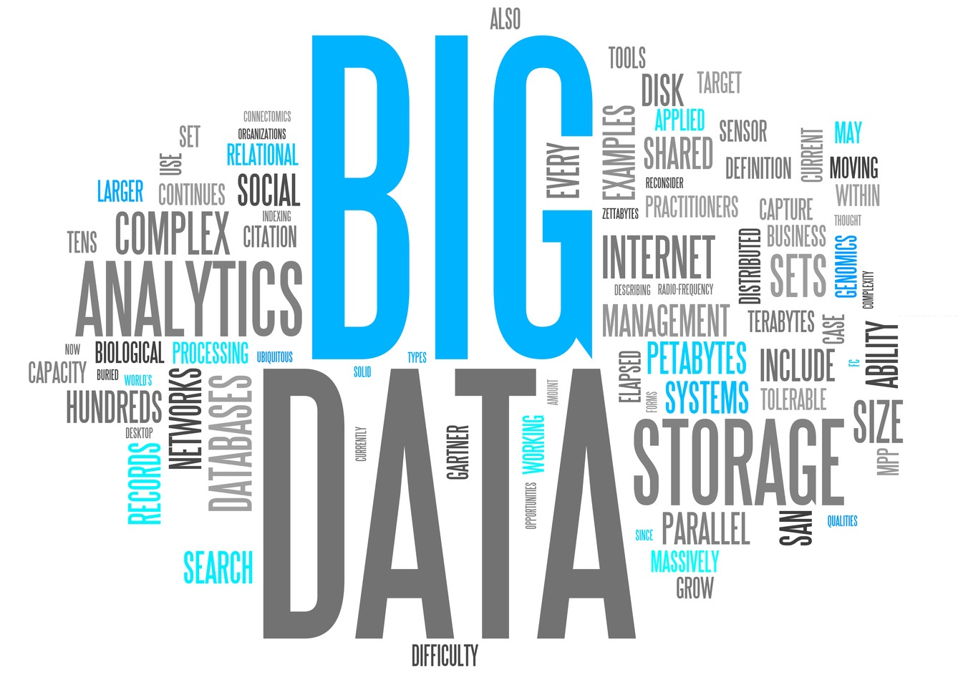
What is Big Data?
Big Data is also data but with a huge size.
Big Data is a term used to describe a collection of data that is huge in size and yet growing exponentially with time.
In short such data is so large and complex that none of the traditional data management tools are able to store it or process it efficiently.

Slide 4
Examples Of Big Data
The New York Stock Exchange
Generates about one terabyte of new trade data per day.
Social Media
The statistic shows that 500+terabytes of new data get ingested into the databases of social media site Facebook, every day.
This data is mainly generated in terms of photo and video uploads, message exchanges, putting comments etc.
A single Jet engine
Can generate 10+terabytes of data in 30 minutes of flight time. With many thousand flights per day, generation of data reaches up to many Petabytes.

Slide 5
Types Of Big Data
BigData could be found in three forms:
Structured
Any data that can be stored, accessed and processed in the form of fixed format
Unstructured
A typical example of unstructured data is a heterogeneous data source containing a combination of simple text files, images, videos etc.
Semi-structured
Can contain both the forms of data.

Slide 6
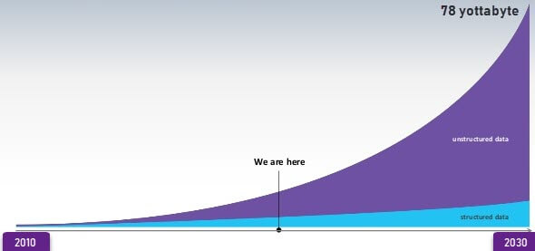
Data Growth over the years

Slide 7
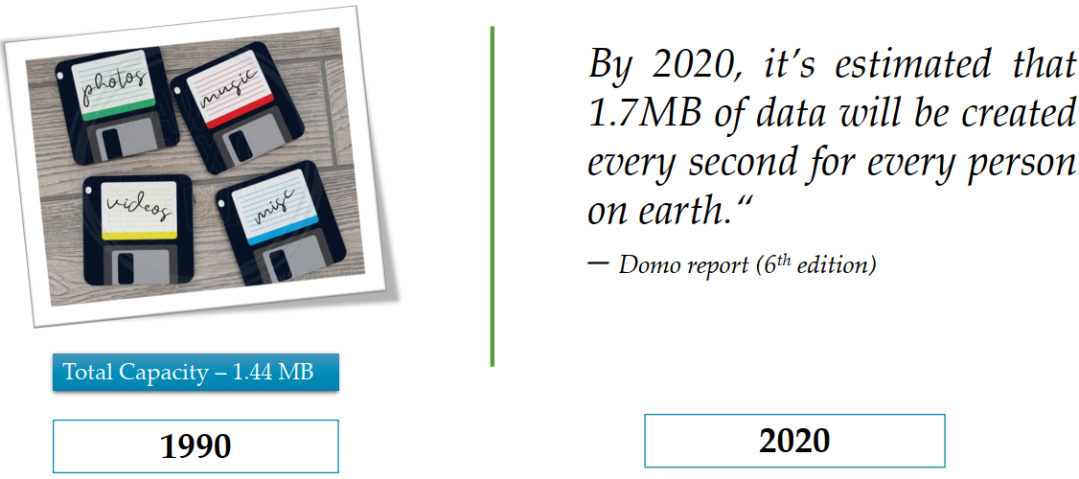
Once upon a time

Slide 8
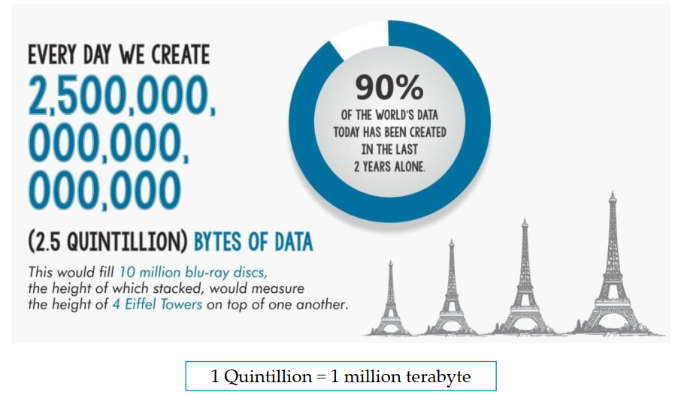
How much data we create daily?

Slide 9
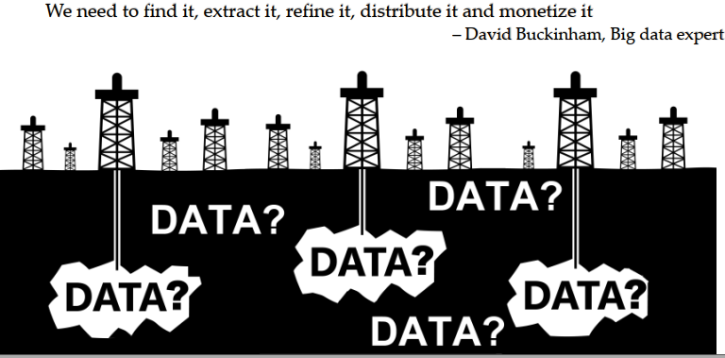
Data is now new oil

Slide 10
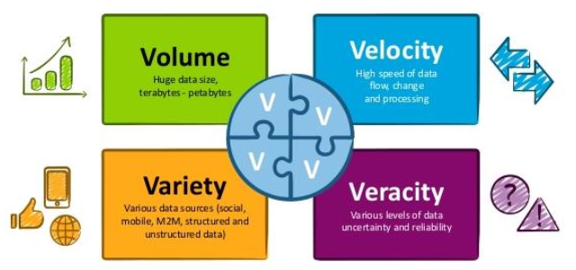
Problem statement
Need a solution which can handle below 4 V’s of data.

Slide 11
Thanks

